Slide 1


The Academy
Article I
Intro to HackTheBox Academy

Slide 2

root@kali:~# nc –nlvp 4444 whoami
I am Diante Jackson, the CougarCS InfoSec Workshops Lead. I am Pentest+ and Splunk CDA Certified, and an avid HackTheBox user dating back to 2017!

Slide 3

Objectives
Learn about HackTheBox
Create a HTB Academy Account
Complete the Introductory HTB Academy Module
Discuss The Academy's Roadmap

Slide 4

What is HackTheBox, and why do we need it?
And more importantly, how can it help you in your career?

Slide 5
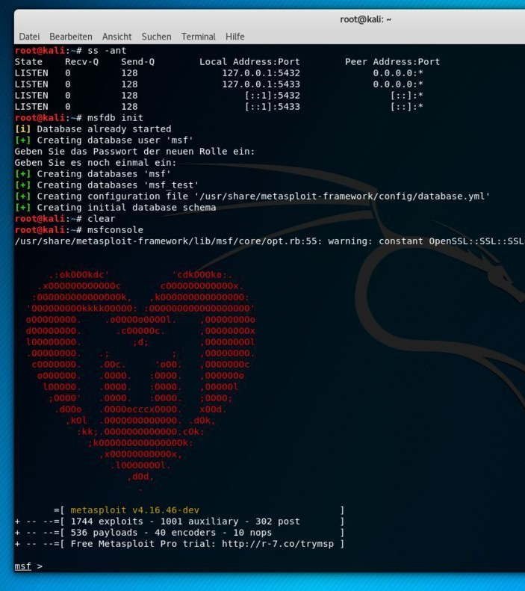
HackTheBox, the #1 CyberSecurity Training Platform
HackTheBox is a training platform that has been the #1 source of training for both students and professionals seeking career growth for many years.
They have a virtual lab network, an Academy program, and a live Capture the Flag competition.

Slide 6
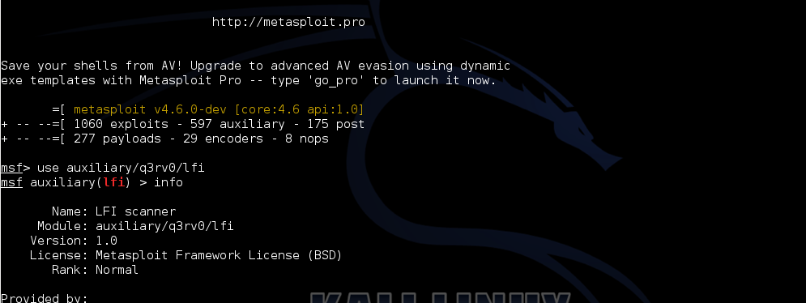
HTB Academy why do we need it?
HackTheBox's Academy has come a long way and has added a large surplus of features that allow aspiring professionals to develop and refine their skillsets like never before. Let's explore further...

Slide 7

Entering the lab
Creating and using our account for the first time!

Slide 8

Create your account!
This referral link benefits all of us! It will give each of us an elevated number of "cubes", the currency the platform uses to unlock different paths.
If QR codes and referral codes don't suit you, just go to the following:
https://academy.hackthebox.com/

Slide 9

Now, let's do the introduction module: INTRODUCTION TO ACADEMY
This module is just an introduction to the structure of the academy; you do not require a great deal of technical knowledge yet.
Happy Hacking!
This Photo by Unknown author is licensed under CC BY-SA.

Slide 10
The Academy's Roadmap
What do we expect? What are our goals? What should we learn?

Slide 11
Expectations
The Academy is the Workshop Team's attempt to further develop and expand cybersecurity knowledge in various disciplined throughout the school year while also encouraging self-growth and developing a learning environment outside of being on campus.
Hopefully, The Academy can have an in-person session once a week, on Thursday afternoons from 4-5pm in PGH room 563. If you are unable to attend a session, these slides will be available within both the CougarCS Infosec Discord server and GitHub account.
We will cover different levels of difficulty and different disciplines such as web exploitation, security operations, forensics, OSINT, malware, and post-exploitation practices during these sessions.

Slide 12
What to Learn
These topics are of extreme importance, so focus on learning these concepts whenever possible between sessions:
Basic Python
Tools
nmap – Network Scanning Tool
metasploit-framework – Exploitation Framework
Linux Command Line (bash/sh/zsh)
The next session will be a walkthrough on basic enumeration concepts and an introduction to the penetration testing lifecycle.

Slide 13
Recommended HTB Academy Modules
Using the Metasploit Framework
Network Enumeration with Nmap
Introduction to Bash Scripting
Introduction to Python 3

Slide 14

Thanks for coming!
The Academy: Article I
Intro to HTB Academy

